Slide 1
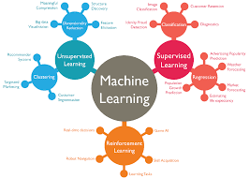
Introduction to ML

Slide 2
Perspectives and Issues in ML
Machine learning is a subfield of artificial intelligence and machine learning algorithms are used in other related fields like natural language processing and computer vision.
Three types of learning are supervised learning, unsupervised learning, and reinforcement learning.
In supervised learning, your system learns under the supervision of the data outputs so supervised algorithms are preferred if your dataset contains output information.

Slide 3
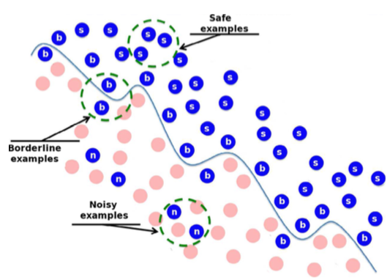

Issues in ML
Data Quality
Data can also be noisy, filled with unwanted information that can mislead a machine learning model into making incorrect predictions.

Slide 4
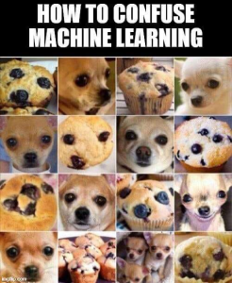



Slide 5
In 2015, a software engineer pointed out that the image-recognition algorithms in Google Photos were labeling his black friends as “gorillas.”
And the nonprofit AlgorithmWatch showed that Google’s Cloud Vision API at one time labeled thermometers held by a black person as “guns” while labeling thermometers held by a light-skinned person as “electronic devices.”

Slide 6
Issuing in labelling
Labels, the annotations from which many models learn relationships in data, also bear the hallmarks of data imbalance.
MIT analysis of popular benchmarks including ImageNet, the researchers found mislabeled images (like one breed of dog being confused for another),
text sentiment (like Amazon product reviews described as negative when they were actually positive), and audio of YouTube videos (like an Ariana Grande high note being categorized as a whistle).

Slide 7
Legacy
The amount of hardware necessary to analyze large quantities of complex, high-quality data is usually unavailable through legacy systems and databases.
Isolation From End Users
Amazon.com Inc's AMZN.O machine-learning specialists uncovered a big problem: their new recruiting engine did not like women.

